Slide 1
AI IN MEDICINE · SEMESTER 5
What Should Adaptive
Cancer Therapy Optimize?
A controlled cross-evaluation of reinforcement-learning reward objectives
Arnav Kumar MD24B003
Rohit Satish Chipde MD24B026
Department of Medical Sciences & Technology
Indian Institute of Technology Madras
Notes:
Two-member team. The project asks whether the reward objective an adaptive-therapy RL agent is trained on actually changes the treatment policy it learns.

Slide 2
THE QUESTION
Six published RL studies of adaptive therapy each optimise
a different objective.
Not one compares its objective against another.
Does the choice of reward objective change the treatment policy —
and if so, by how much, and at what cost on the objectives it was not trained for?
This is a comparative contribution, not a new algorithm. PPO is the instrument, deliberately not the claim.
1
Notes:
Say this slowly. The whole project is one question. Everything after this is either evidence that the question is open, or the design that answers it.

Slide 3
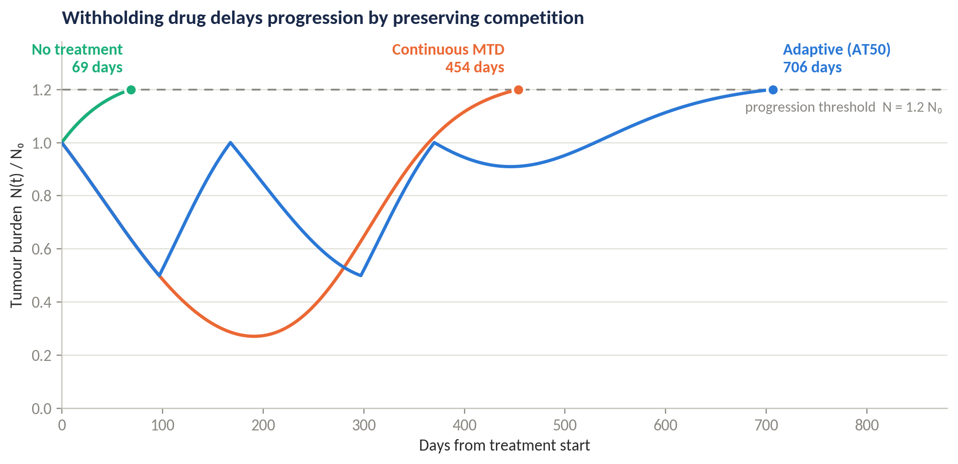
THE CLINICAL PROBLEM
Continuous dosing selects for resistance
Maximum-tolerated-dose therapy kills sensitive cells fastest — and by clearing them, releases the resistant clone from competition into an emptied niche. Competitive release is the dominant failure mode of systemic therapy.
Adaptive therapy
Withdraw drug once the burden falls, retaining sensitive cells to suppress the resistant population; resume when it recovers.
The tumour is contained rather than cured — progression is deferred, not raced toward.
Our own simulation of the Strobl (2021) model — not a figure reproduced from a paper.
2
Notes:
The figure is ours — we implemented the ODE model ourselves. Point at the three progression markers.

Slide 4
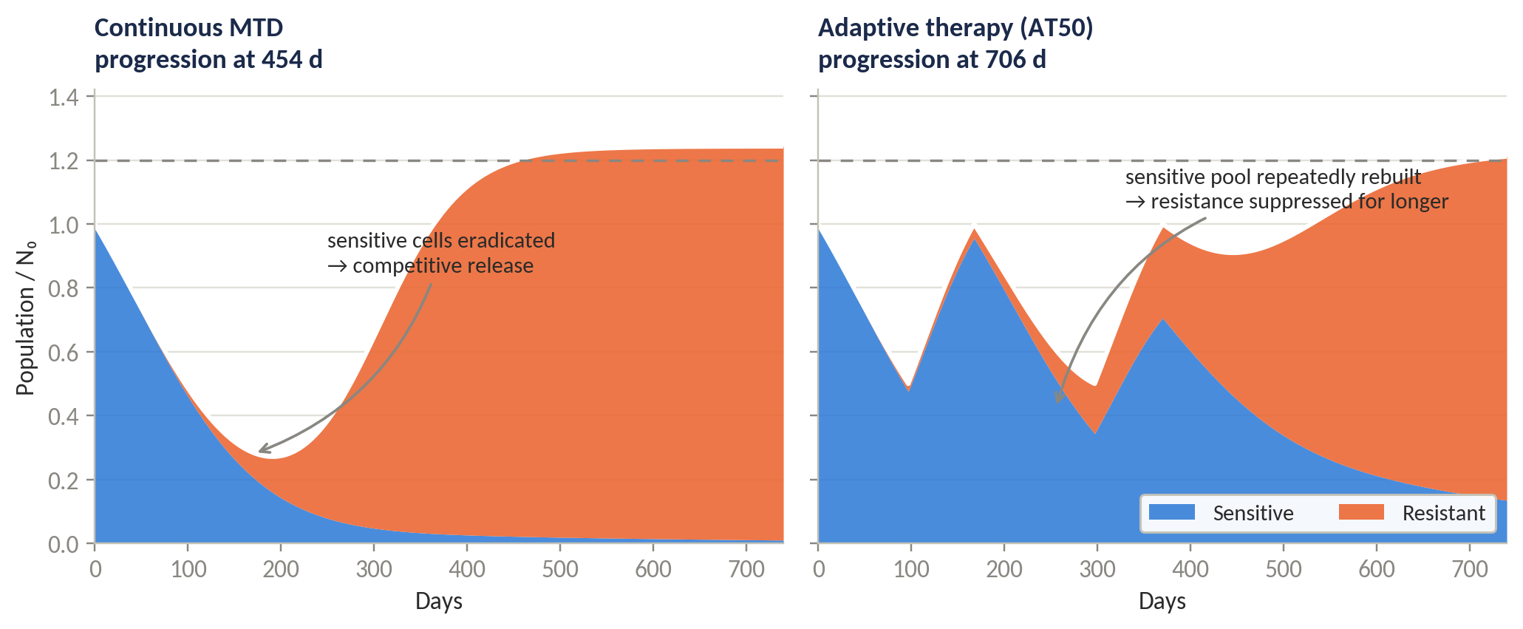
THE MECHANISM
Why withholding the drug buys time
Clinical evidence
Not only a modelling claim — a prospective pilot in mCRPC.
~½
the cumulative abiraterone dose of the standard continuous schedule
Zhang et al., Nature Communications 2017; follow-up in eLife 2022
Under MTD the sensitive pool is eradicated and the resistant clone expands unopposed. Under adaptive therapy the sensitive pool is repeatedly rebuilt, and it keeps doing the suppressing.
3
Notes:
Left panel: competitive release. Right panel: containment. The Zhang trial is the reason this is not purely theoretical.

Slide 5
PRIOR WORK
Six papers, six objectives, zero comparisons
Study | What the reward optimises | Environment | Compares?
Gallagher 2023/24 | Survival time + drug-holiday bonus | 2-pop Lotka-Volterra (Strobl) | No
Ma 2026 | Same weights, "adapted and simplified" | 2-pop LV, cytostatic drug | No
Giles & Newton 2026 | Shannon entropy of composition | Moran process, fixed N | No
Weaver 2024 | 1 − population fitness | Empirical fitness landscapes | No
Yao 2024 | Durability: post-withdrawal regrowth | ODE tumour–immune | No
Gluzman 2020 | Cumulative dose + time (optimal control, not RL) | Replicator EGT | No
Every objective is welded to the environment it was written for — and that welding is exactly why the comparison has never been run.
Note that Gluzman is optimal control rather than reinforcement learning — we label it as such rather than describing all six as RL papers.
4
Notes:
Note Gluzman is optimal control, not RL — we label it correctly rather than calling all six RL papers.

Slide 6
THE GAP
The objectives are not commensurable as written
Entropy over 3 populations
A drug-holiday bonus
A dose penalty
is not the same quantity as entropy over 2. On a two-population simplex its maximum sits at a 50% resistant fraction.
is undefined in a fixed-population Moran process, which has no tumour volume to withhold treatment against.
collapses into "minimise time on treatment" the moment the action space is binary — indistinguishable from a holiday bonus.
Unwelding them — porting each objective into one shared environment where they become commensurable — is the work. It is also why nobody has done it.
Giles & Newton name the gap themselves: they position their entropy reward as "a complementary resistance-management objective" to Weaver's fitness minimisation — asserting complementarity without ever testing it.
5
Notes:
The quote is verified verbatim from the PDF. It is the strongest single piece of evidence that the gap is real and acknowledged in the field.

Slide 7
THE AI TASK
Sequential decision-making, not classification
Tumour state
Observation
Policy
Dose
Environment
S, R from the ODE
→
every 28 d, noisy
→
recurrent PPO agent
→
0, ½ or full
→
integrate forward
Input Normalised subpopulation sizes S/K, R/K and burden N/N₀ — never raw counts, which will not train.
Output Dose level at each decision point, held between observations.
Task type Partially observed Markov decision process control. The reward function is the variable under study, not the algorithm.
Progression is checked at every integration step, not only at decision points — otherwise a fast-growing tumour progresses and recovers unobserved, silently overstating time to progression.
6
Notes:
Flag the normalisation and the continuous progression check — both are implementation traps that cost a week if found late.

Slide 8
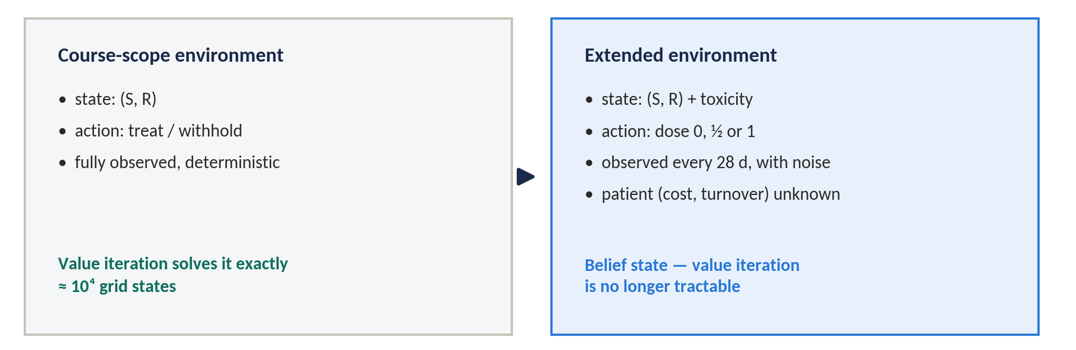
THE OBVIOUS OBJECTION
"Why do you need RL at all?"
On a two-dimensional deterministic state with a binary action, value iteration returns the exact optimum — no seeds, no instability, no variance. If that were the whole environment, the agent would only be reproducing what we could already compute.
So we use value iteration deliberately — as a per-objective optimality ceiling, not a competitor. The agents are trained where it cannot follow.
7
Notes:
This is the sharpest attack available and we answer it head-on. The claim becomes "reached 96% of the computable optimum", not "beat AT50".

Slide 9
THE COMPARISON
Two objectives, one controlled variable
R1
Survival with holidays
R4
Durability
Gallagher 2023/24 — the field default, our control condition
Yao 2024 — leaving the tumour controllable
+0.1 per timestep survived
+0.05 per timestep off treatment
−0.1 on progression, +5 on horizon
+0.1 per timestep survived
−0.1 on progression
terminal penalty on resistant regrowth over 180 withdrawn days
The two rewards share an identical survival term and progression penalty, and differ only in the third term. That isolates the variable — otherwise "the objective changed" is confounded with "the reward was shaped differently".
We rejected a survival-versus-coexistence pairing: a faithful entropy port to two populations peaks at a 50% resistant fraction, so the agent would deliberately grow resistance and divergence would be guaranteed in advance by a porting artefact. That variant is kept as a documented secondary result.
8
Notes:
If asked why not the entropy objective: because it would have produced a foregone conclusion. Choosing the pair that maximises information, not the pair that maximises apparent difference.

Slide 10
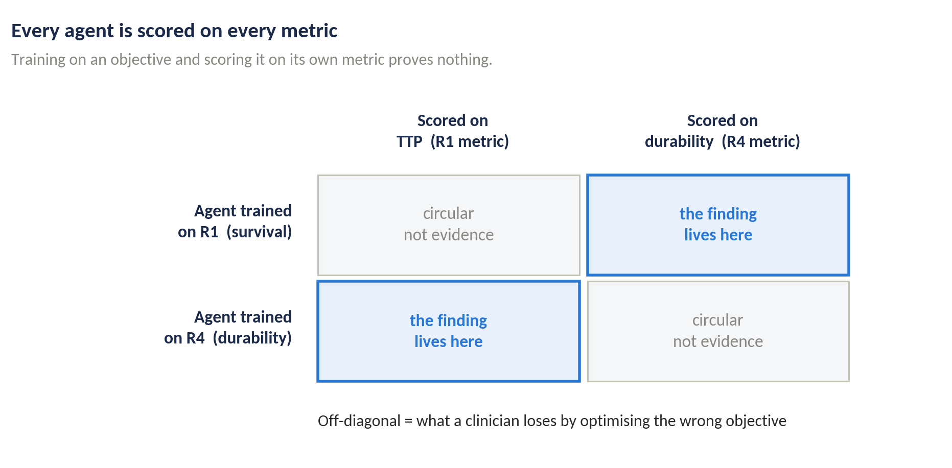
THE CORE DESIGN
The finding lives off the diagonal
Why not just the diagonal?
Training on an objective and scoring it on its own metric is circular. A reviewer would say so in the first paragraph.
What the off-diagonal buys
The cost of the wrong objective: if a clinician cares about durability, how much is lost by training on survival?
That is the number a translational reader wants, and no single-objective paper can produce it.
Instrumental convergence is the headline we are hunting: does the durability-trained agent achieve longer time to progression than the survival-trained one?
9
Notes:
Plausible rather than perverse: durability is instrumentally useful over long horizons while a per-step survival bonus can be myopic.

Slide 11
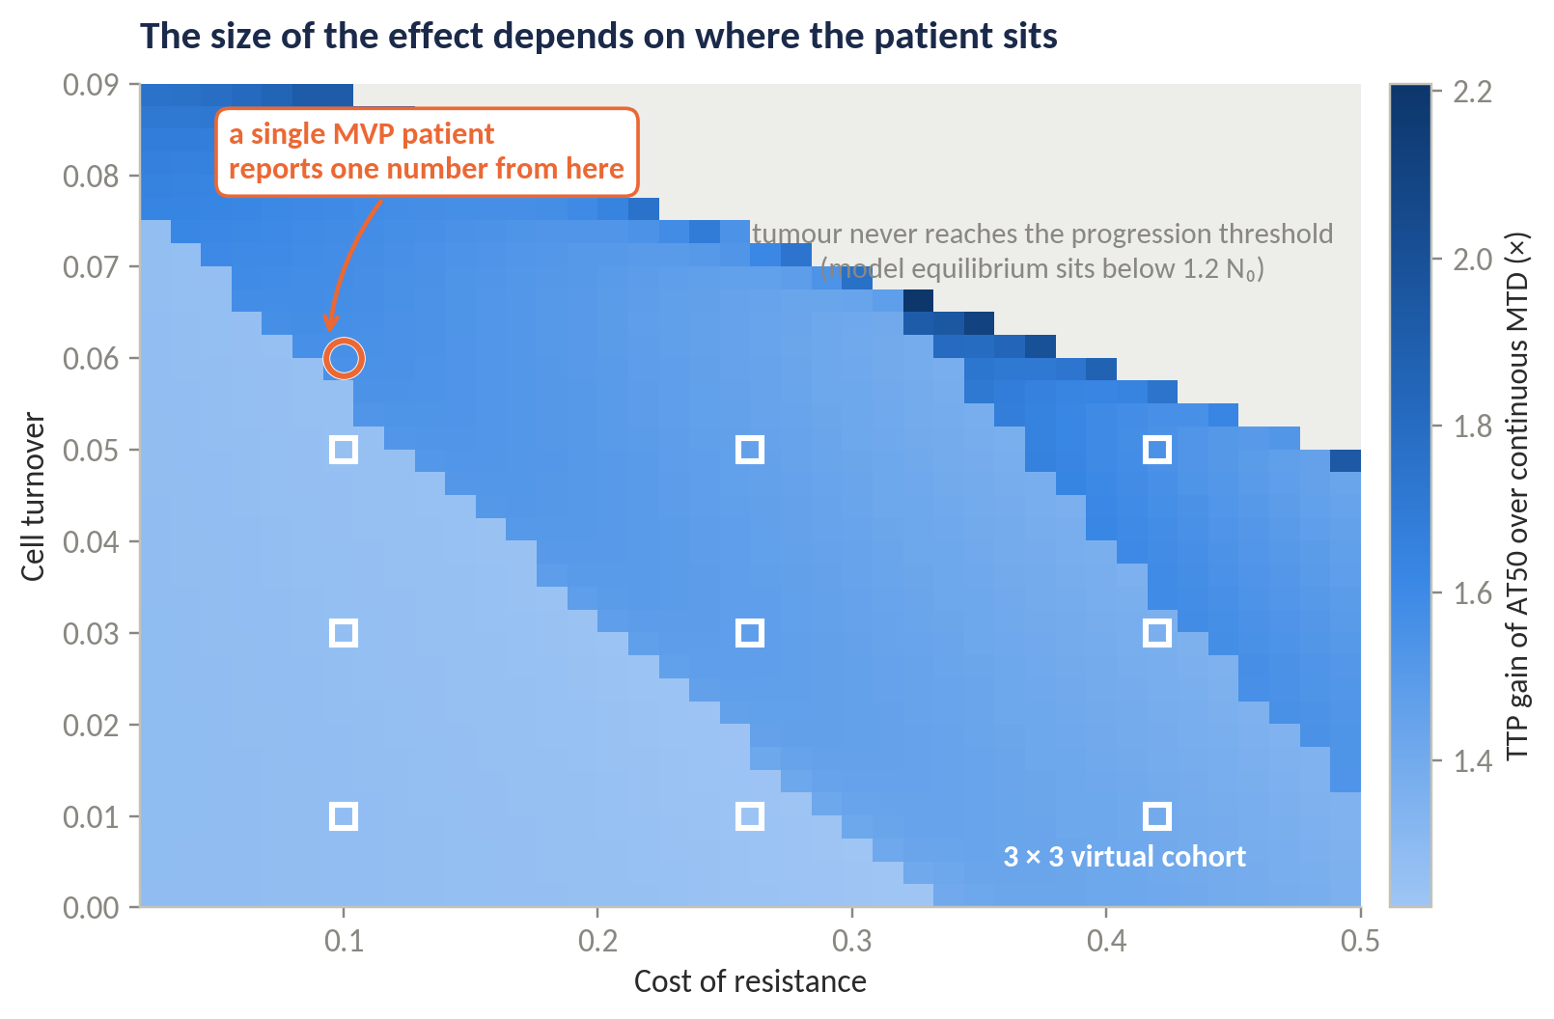
SCOPE
One patient cannot answer this
How much the objective matters is not a number — it is a function of where the patient sits.
AT50 gains between 1.2× and 2.2× over MTD across the plane — a 30%+ swing.
In the grey region the tumour never reaches the progression threshold, so TTP is undefined entirely.
The MVP therefore trains on a 3 × 3 virtual cohort, not one proof-of-principle patient.
Same parameter space Strobl and Gallagher sweep — so our robustness result stays comparable to theirs.
Compute is not the constraint: a two-state ODE trains the full grid on CPU.
10
Notes:
If someone says "just do one patient for the MVP" — this is the answer. The cohort is load-bearing, not a stretch goal.

Slide 12
BASELINES
Beating MTD is table stakes, not success
Baseline | Definition | Why it is in the suite
No treatment | D = 0 throughout | The floor
Continuous MTD | D = D_max throughout | The universal comparator
AT50 | Dose until N < 0.5 N₀, withdraw until N ≥ N₀ | The clinical protocol as trialled
AT-x sweep | Withdrawal threshold over {25, 50, 75, 90}% | The tuned-heuristic ceiling — clearing this is a real result
Intermittent | Fixed 30 days on, 30 days off | Not response-triggered; isolates the value of feedback
AT-PSC | Partial cycle, 13 of 30 days | Current best mechanistic rule (Ma 2026)
Value iteration | Discretised (S, R) grid, solved per objective | The computable optimum — the strongest comparator
The claim becomes "the agent reached 96% of the computable optimum for its own objective" — which is far harder to dismiss than "the agent beat AT50".
Each objective has its own optimum, so value iteration is solved separately per objective — a column of ceilings, not a single number.
11
Notes:
Each objective has its own optimum, so value iteration is solved separately per objective — a column of ceilings, not one number.

Slide 13
EVALUATION
What would count as a real difference
Outcome metrics
Policy-space metrics
Time to progression
Cumulative dose, and as % of MTD
Mean and terminal resistant fraction
Post-withdrawal regrowth over 180 d
Maximum burden reached
Switching threshold N*, from a sigmoid fit to P(treat) against burden
Pairwise KL divergence between state–action distributions on a shared grid
Two policies can match on outcome and still differ in states the trajectories rarely visit — only these will show it
1
Statistics Median and the full seed distribution, never the mean alone — RL's advantage here is often low variance rather than a higher peak (Eastman 2021).
2
Seeds At least ten agents per objective per cohort patient. Single-seed results in this domain mislead.
3
Pre-registered A cross-objective difference is claimed only if it exceeds the within-objective seed-to-seed spread. Committed before seeing results.
12
Notes:
Pre-registering the significance threshold is what separates a result from noise. Say that we commit to it now.

Slide 14
FEASIBILITY
We have already built and checked the environment
Experiment 0 is the correctness gate: reproduce the published benchmark before trusting anything downstream. Our independent re-implementation already lands close.
454 d
0.7%
706 d
5%
our continuous-therapy result
against a published 451 d
error on the continuous-therapy
benchmark, before any tuning
our AT50 result against
a published 672 d
residual gap — exactly what
Experiment 0 exists to close
The gap will be closed against the authors' published parameters — not by tuning until the numbers agree.
We have also already caught a factor-of-two discrepancy between how Strobl and Gallagher write the drug kill term. Left undetected it would have made E0 fail, and the week would have gone on debugging the agent rather than the environment.
13
Notes:
This slide is the credibility slide. We are not proposing to start — we have started, and the environment already reproduces the literature to within 1% on one benchmark.

Slide 15
PLAN
Eight weeks, two members
Week | Work | Deliverable | Lead
1 | Environment, parameter resolution, E0 correctness gate | Benchmark reproduced | Arnav
2 | Baseline suite (E1); value-iteration harness begun (E2) | Baseline comparison table | Arnav
2–3 | E-ext: graded dosing, observation intervals, noise, belief state | Extended environment, tested | Rohit
3–4 | PPO training harness; R1 trained, 10 seeds | R1 training stably | Rohit
5 | R4 implemented and trained; value iteration completed | Both objectives + ceilings | Both
6 | Cohort runs across the 3 × 3 grid (E6); cross-evaluation (E4) | Core result matrix | Both
7 | Policy divergence (E5), statistics, figures | Divergence figure | Arnav
8 | Write-up, reproducibility package, presentation | Report, code release, deck | Both
Python, Gymnasium-compatible environment, PPO from Stable-Baselines3 with pinned versions, fixed-step RK4 integration. All seeds and configs committed — the reproducibility package is itself a deliverable.
14
Notes:
Both members review each other code; the write-up is shared. Leads indicate primary ownership, not sole ownership.

Slide 16
RISKS
What could go wrong, and the answer
Risk | Mitigation
Benchmark parameters sit in supplementary material absent from our corpus | Pull from the authors' public repository in Week 1. Fallback: proceed with a documented, self-consistent set and report the gap openly.
The Yao paper defining R4 is not in our corpus — the reward form is unverified | Retrieve in Week 1, before any R4 training. If unobtainable, R4 is labelled as our operationalisation of durability, not attributed to Yao.
Factor-of-two discrepancy in the drug kill term | Already caught. Resolved against published code in Week 1 — and E0 will not pass if it is wrong, which is the point of a gate.
PPO unstable on the extended environment inside the window | Decision point at end of Week 4: fall back to value iteration as primary instrument with RL as a recovery check. Narrower, still complete.
Every risk above has a named week, a named owner, and a fallback that still produces a complete report. None of them can silently consume the project.
Decision point, end of Week 4 — the single line that guarantees a submittable result regardless of how training goes.
15
Notes:
The Week 4 decision point is the single most important line here — it guarantees a submittable result regardless of how training goes.

Slide 17
OUTCOMES
What we claim, and what we do not
What we will deliver
What we do not claim
A quantified answer, in either direction, on whether the objective changes the policy
A correctness-verified shared environment in two tiers, with ported objectives and per-objective ceilings
A reproducible cross-evaluation pipeline that extends to the remaining objectives beyond this course
A documented, falsifiable null-result path
No clinical applicability — a simulation study on a virtual cohort, no treatment recommendation follows
Two objectives of at least four, on a nine-patient cohort
No spatial structure, pharmacokinetics, phenotypic switching or de novo mutation
Resistance is pre-existing, binary and irreversible by assumption
The translational path, stated plainly
For this to inform a trial, three things must become true: the environment fitted to longitudinal patient biomarkers rather than a parameter grid; the policy validated against held-out patients rather than its own simulator; and the objective chosen in consultation with clinicians rather than inherited from a previous paper.
The third is what this project is about — and it is the one that can be settled in silico.
16
Notes:
West et al. 2023 pose exactly this question in their survey of open problems — what should the control target be.

Slide 18
IN SUMMARY
1
The question is open
Six objectives, six environments, zero comparisons — and the field says so itself.
2
The design escapes circularity
Every agent scored on every metric; the finding lives in the off-diagonal.
3
The instrument is justified
Value iteration where it is exact, reinforcement learning only where it cannot follow.
4
The result is falsifiable either way
Pre-registered threshold, seed distributions, a documented null-result path.
Arnav Kumar MD24B003 · Rohit Satish Chipde MD24B026 · DoMST, IIT Madras
17
Notes:
Close on the falsifiability point — it is what makes this a real experiment rather than a demonstration.

Slide 19
REFERENCES
Key literature
Gatenby RA, Silva AS, Gillies RJ, Frieden BR. Adaptive therapy. Cancer Research. 2009;69(11):4894–4903.
Zhang J, Cunningham JJ, Brown JS, Gatenby RA. Integrating evolutionary dynamics into treatment of metastatic castrate-resistant prostate cancer. Nature Communications. 2017;8(1):1816.
Zhang J, et al. Evolution-based mathematical models significantly prolong response to abiraterone in mCRPC. eLife. 2022;11:e76284.
Strobl MAR, West J, Viossat Y, et al. Turnover modulates the need for a cost of resistance in adaptive therapy. Cancer Research. 2021;81(4):1135–1147.
Gallagher K, Strobl M, Gatenby R, Maini P, Anderson A. Learning to adapt — deep RL in treatment-resistant prostate cancer. bioRxiv. 2023. doi:10.1101/2023.04.28.538766
Gallagher K, et al. Mathematical model-driven deep learning enables personalized adaptive therapy. Cancer Research. 2024.
Gluzman M, Scott JG, Vladimirsky A. Optimizing adaptive cancer therapy: dynamic programming and evolutionary game theory. Proc. R. Soc. B. 2020;287(1925):20192454.
Weaver DT, King ES, Maltas J, Scott JG. RL informs optimal treatment strategies to limit antibiotic resistance. PNAS. 2024;121(16):e2303165121.
Eastman B, Przedborski M, Kohandel M. RL derived chemotherapeutic schedules for robust patient-specific therapy. Scientific Reports. 2021;11:17882.
RL for chemotherapy scheduling in a stochastic tumor evolution model. Physical Review E. 2026;113:064404.
Kiram FME, et al. Recurrent deep RL for chemotherapy control under partial observability. arXiv:2605.02552. 2026.
West J, Adler F, Gallaher J, et al. A survey of open questions in adaptive therapy. eLife. 2023.
Wang M, Scott JG, Vladimirsky A. Threshold-awareness in adaptive cancer therapy. PLOS Comput. Biol. 2024;20(6):e1012165.
Viossat Y, Noble R. A theoretical analysis of tumour containment. Nature Ecology & Evolution. 2021;5(6):826–835.
18
Notes:
Yao 2024 and Gevertz 2026 are named in the proposal as to-be-retrieved in Week 1 and are deliberately not listed here as verified.

